Slide 1
🧠 MySQL Subqueries

Slide 2
A subquery (or nested query) in MySQL is a query inside another query. It is used to fetch data that will be used by the main (outer) query for filtering, comparison, or aggregation.
A subquery is a query embedded within another SQL query (like SELECT, INSERT, UPDATE, or DELETE).
It is enclosed within parentheses ( ) and returns data to the outer query.
SELECT column_name
FROM table_name
WHERE column_name OPERATOR (
SELECT column_name FROM another_table WHERE condition
);

Slide 3
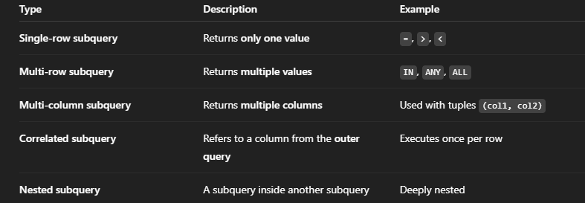
Types of Subqueries

Slide 4
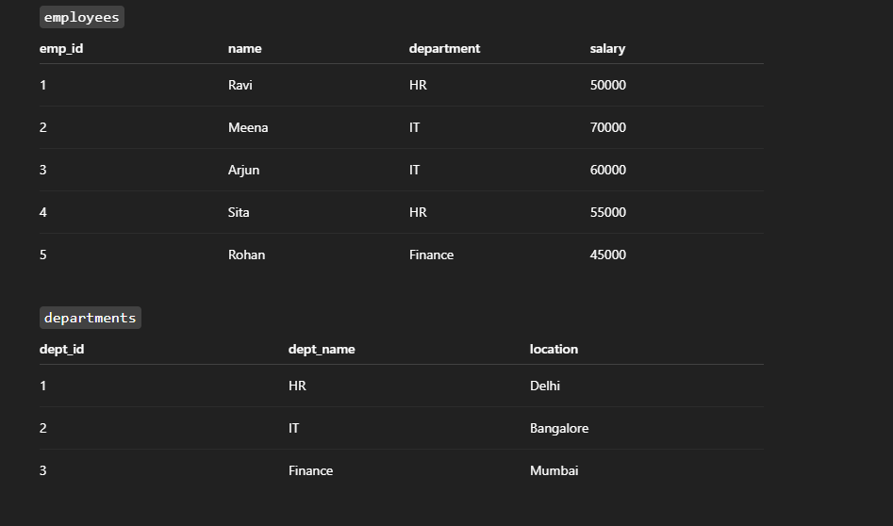
Example tables

Slide 5
Types of Subqueries with Examples

Slide 6
✅ (a) Single-Row Subquery
Find employees who earn more than the average salary.
SELECT name, salary
FROM employees
WHERE salary > (SELECT AVG(salary) FROM employees);
Output: Employees with salary above the average.

Slide 7
✅ (b) Multi-Row Subquery
Find employees who work in departments located in Bangalore or Mumbai.
SELECT name, department
FROM employees
WHERE department IN (
SELECT dept_name FROM departments WHERE location IN ('Bangalore', 'Mumbai')
);

Slide 8
✅ (c) Correlated Subquery
A subquery that runs once for each row in the outer query.
Find employees who earn more than the average salary in their own department.
SELECT e1.name, e1.department, e1.salary
FROM employees e1
WHERE e1.salary > (
SELECT AVG(e2.salary)
FROM employees e2
WHERE e1.department = e2.department
);

Slide 9
✅ (d) Subquery with EXISTS
Check if there are any employees in the IT department.
SELECT dept_name
FROM departments d
WHERE EXISTS (
SELECT 1 FROM employees e WHERE e.department = d.dept_name
);

Slide 10
✅ (e) Subquery in FROM Clause (Inline View)
You can use a subquery as a temporary table.
Find departments with average salary above 55,000:
SELECT department, avg_salary
FROM (
SELECT department, AVG(salary) AS avg_salary
FROM employees
GROUP BY department
) AS dept_summary
WHERE avg_salary > 55000;
Output: IT department only.

Slide 11
✅ (f) Subquery with INSERT
Insert data based on another table:
INSERT INTO high_earners (emp_id, name, salary)
SELECT emp_id, name, salary
FROM employees
WHERE salary > (SELECT AVG(salary) FROM employees);

Slide 12
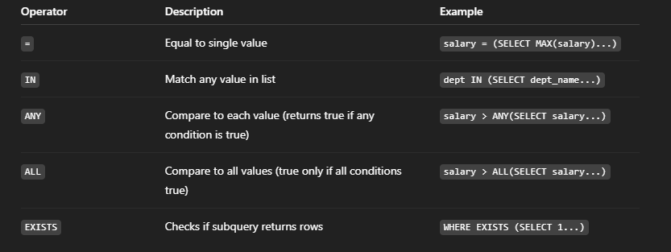
Operators Used with Subqueries

Slide 13
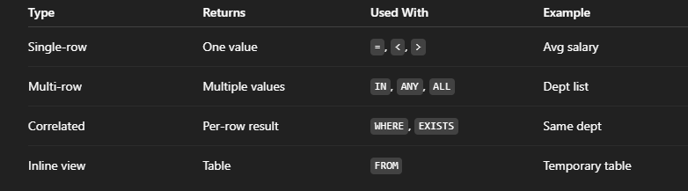

Slide 14
MySQL JOINS

Slide 15
What Are Joins in MySQL?
A JOIN is used to combine rows from two or more tables based on a related column between them.
It helps you fetch related data stored in multiple tables (normalized database).
SELECT columns
FROM table1
JOIN table2
ON table1.common_column = table2.common_column;

Slide 16
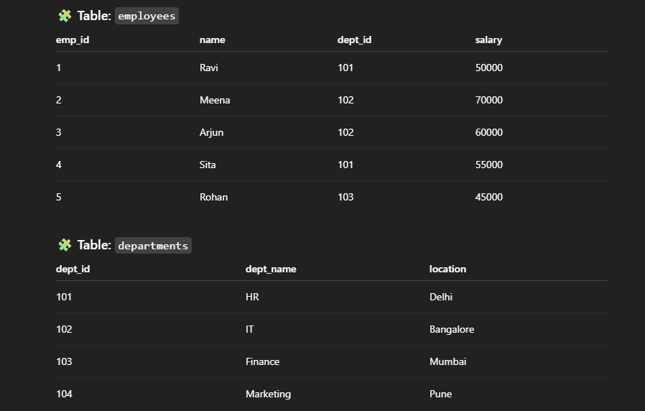
Example Tables

Slide 17
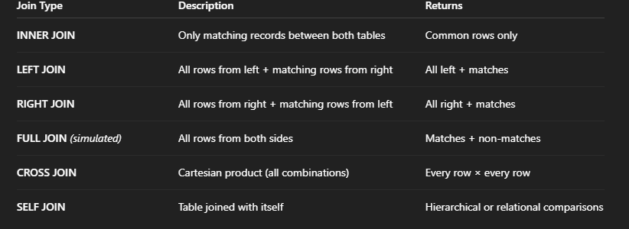
Types of Joins

Slide 18
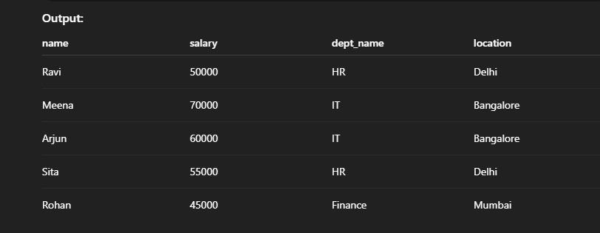
✅ a) INNER JOIN
SELECT e.name, e.salary, d.dept_name, d.location
FROM employees e
INNER JOIN departments d
ON e.dept_id = d.dept_id;

Slide 19
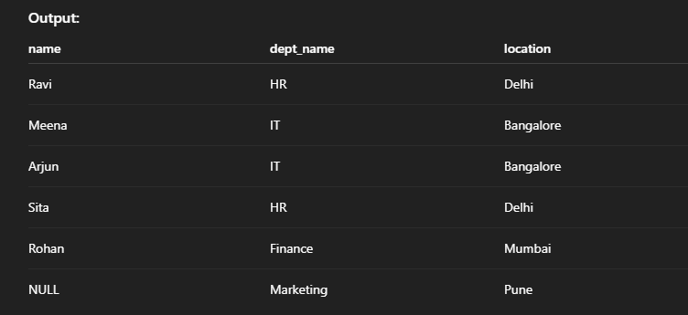
✅ b) LEFT JOIN
Returns all rows from the left table (employees) and matching rows from right table (departments).
SELECT e.name, e.salary, d.dept_name, d.location
FROM employees e
LEFT JOIN departments d
ON e.dept_id = d.dept_id;
If an employee’s dept_id doesn’t match, those rows will still appear with NULL values.

Slide 20
✅ d) FULL OUTER JOIN (MySQL doesn’t have directly — use UNION)
Returns all rows from both tables, matched or unmatched.
SELECT e.name, d.dept_name
FROM employees e
LEFT JOIN departments d
ON e.dept_id = d.dept_id
UNION
SELECT e.name, d.dept_name
FROM employees e
RIGHT JOIN departments d
ON e.dept_id = d.dept_id;

Slide 21
✅ e) CROSS JOIN
Returns every possible combination of both tables.
SELECT e.name, d.dept_name
FROM employees e
CROSS JOIN departments d;
If employees has 5 rows and departments has 4 rows → 5 × 4 = 20 results.

Slide 22
✅ f) SELF JOIN
Table joined with itself — useful for hierarchical data.
Example: Find employees who earn more than another employee.
SELECT e1.name AS Employee, e2.name AS Lower_Paid_Employee
FROM employees e1
JOIN employees e2
ON e1.salary > e2.salary;

Slide 23


Slide 24
Joins with WHERE vs ON
These two are not always the same:
-- Using ON (preferred)
SELECT * FROM employees e
LEFT JOIN departments d
ON e.dept_id = d.dept_id AND d.location = 'Delhi';
-- Using WHERE (filters after join)
SELECT * FROM employees e
LEFT JOIN departments d
ON e.dept_id = d.dept_id
WHERE d.location = 'Delhi’;
The first keeps unmatched employees (with NULLs), the second filters them out, acting like an INNER JOIN.

Slide 25
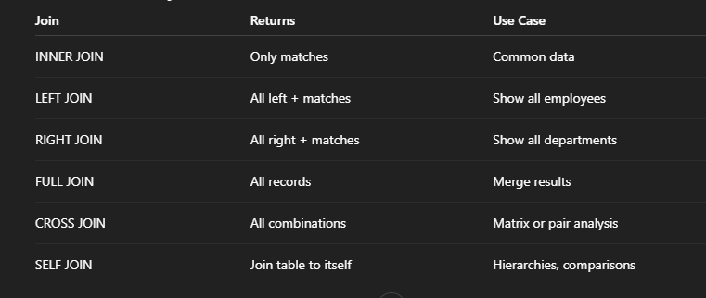

Slide 26
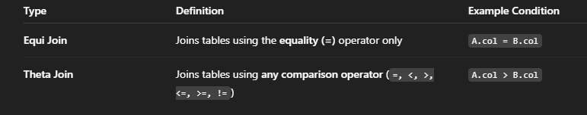
Equi Join and Theta Join in MySQL
What Are Equi Join and Theta Join?

Slide 27
EQUI JOIN
An Equi Join combines rows from two or more tables where the join condition uses = (equality).
It is the most common and is used internally by INNER JOIN and NATURAL JOIN.

Slide 28
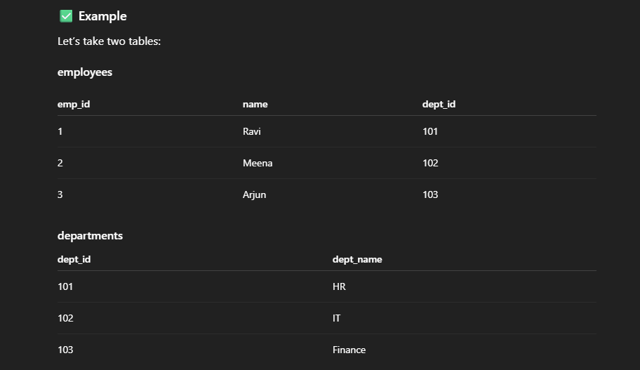

Slide 29
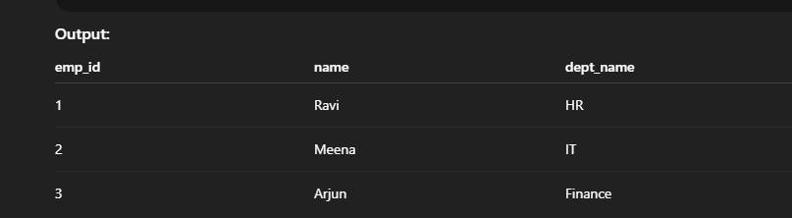
Query Using Equi Join
SELECT e.emp_id, e.name, d.dept_name
FROM employees e, departments d
WHERE e.dept_id = d.dept_id;
Or
SELECT e.emp_id, e.name, d.dept_name
FROM employees e
INNER JOIN departments d
ON e.dept_id = d.dept_id;

Slide 30
THETA JOIN
A Theta Join is a more general form — it allows any comparison operator (=, <, >, <=, >=, !=).
That means Equi Join is a special case of Theta Join.

Slide 31
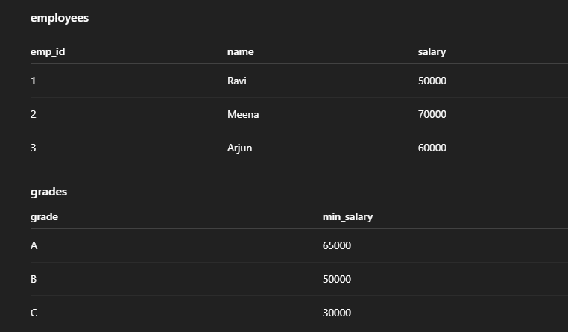
Example: Using > operator

Slide 32
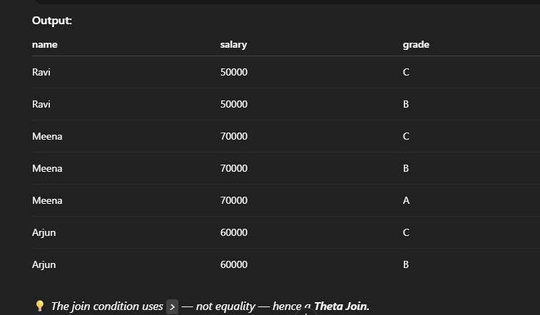
Theta
SELECT e.name, e.salary, g.grade
FROM employees e, grades g
WHERE e.salary > g.min_salary;

Slide 33
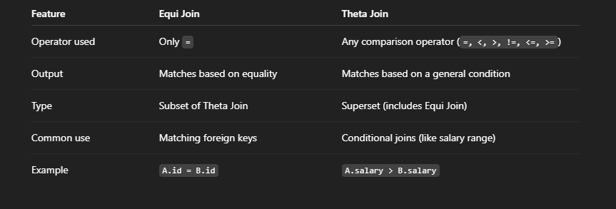

Slide 34
In MySQL, the following are internally Equi Joins:
INNER JOIN
LEFT JOIN
RIGHT JOIN
NATURAL JOIN
Theta joins are custom joins where you specify your own logical comparison condition.

Slide 35
ACID Properties
ACID stands for: Atomicity, Consistency, Isolation, and Durability.
These are the core principles that ensure reliable transaction processing in databases.
What Is a Transaction?
A transaction is a logical unit of work — one or more SQL statements executed together. Example:
START TRANSACTION;
UPDATE accounts SET balance = balance - 5000 WHERE acc_no = 101;
UPDATE accounts SET balance = balance + 5000 WHERE acc_no = 202;
COMMIT;
Either both statements succeed, or none — that’s the power of ACID.

Slide 36
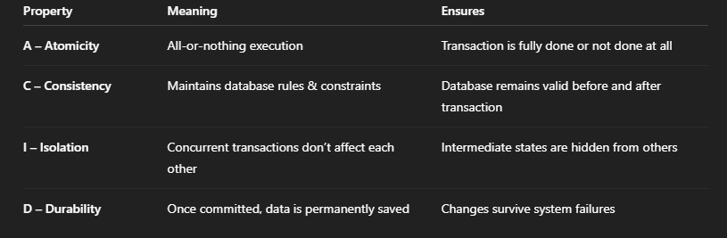
The 4 ACID Properties

Slide 37
A. Atomicity (All or Nothing)
A transaction must be fully completed or fully rolled back.
If one part fails, the entire transaction fails.
If you transfer ₹5000 from Account A to Account B:
Debit ₹5000 from A ✅
Credit ₹5000 to B ❌ (fails)
Then → ROLLBACK, so A’s money is not lost.
START TRANSACTION;
UPDATE accounts SET balance = balance - 5000 WHERE acc_no = 1;
UPDATE accounts SET balance = balance + 5000 WHERE acc_no = 2;
ROLLBACK; -- if error occurs
COMMIT; -- if success

Slide 38
B. Consistency
A transaction must bring the database from one valid state to another.
All constraints, triggers, and data integrity rules must hold true after the transaction.
🧩 Example:
Total money in system (A + B) must remain the same before and after transfer.
Primary keys, foreign keys, and data types remain valid.
💡 No data rule is broken.

Slide 39
🧠 C. Isolation
Each transaction should act independently as if it’s the only one running.
Even if multiple users work together, they shouldn’t see each other’s partial results.
🧩 Example: Two users transferring money at the same time — each transaction runs in isolation.
SQL Isolation Levels in MySQL:
READ UNCOMMITTED – may see uncommitted data (dirty reads)
READ COMMITTED – sees only committed data
REPEATABLE READ (default) – ensures stable reads within a transaction
SERIALIZABLE – highest isolation; transactions execute one after another

Slide 40
🧠 D. Durability
MySQL writes data to logs and disk so it can recover committed changes after restart.
🧩 Example: After transferring ₹5000 successfully → COMMIT → power failure → system restarts → transaction remains saved.

Slide 41
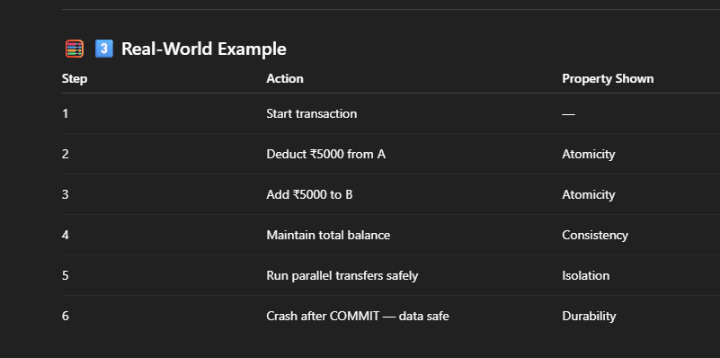

Slide 42
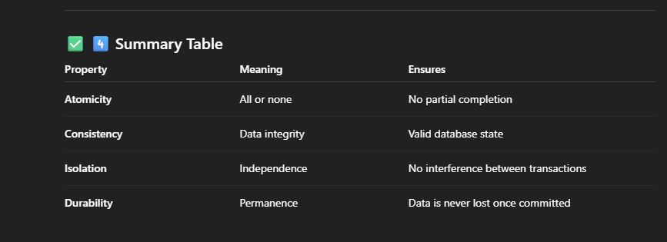

Slide 43
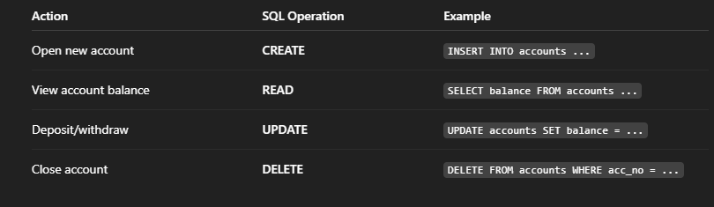
CRUD Operations in MySQL
CRUD stands for: C – Create, R – Read, U – Update, D – Delete These are the four basic operations you perform on data in any relational database.

Slide 44
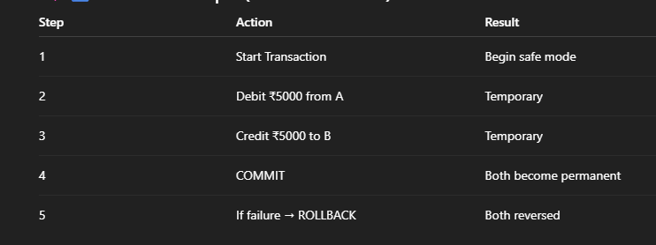
Transactions – Commit and Rollback

Slide 45
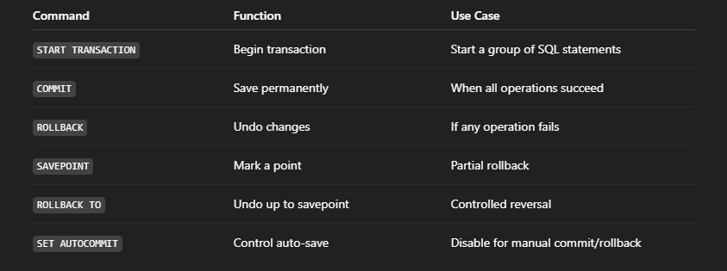

Slide 46
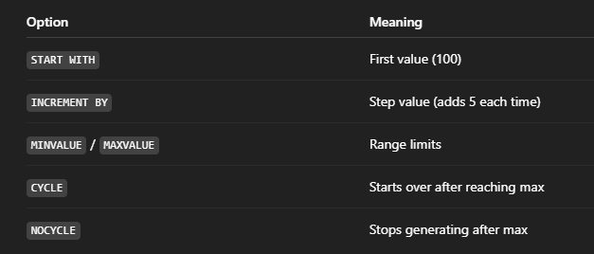
SEQUENCE in MySQL
A sequence is a database object that generates a series of unique numbers — usually used for primary keys or ID columns.
Think of it as a counter that automatically increments with each new record.
CREATE SEQUENCE emp_seq
START WITH 100
INCREMENT BY 5
MINVALUE 100
MAXVALUE 1000
CYCLE;

Slide 47
Next Value
SELECT NEXT VALUE FOR emp_seq;
👉 Returns 100 (first value)
Next time you call it, it returns 105, 110, 115... and so on.
Use in Insert:
INSERT INTO employees (emp_id, name)
VALUES (NEXT VALUE FOR emp_seq, 'Amit’);
Now emp_id = 100, then 105, then 110, etc.
View Sequence Details: SHOW CREATE SEQUENCE emp_seq;
Restart Sequence ALTER SEQUENCE emp_seq RESTART WITH 200;
DROP SEQUENCE emp_seq;

Slide 48
Example: Auto-Generating Invoice Numbers
CREATE SEQUENCE invoice_seq START WITH 5000 INCREMENT BY 1;
CREATE TABLE invoices (
invoice_no INT PRIMARY KEY,
customer_name VARCHAR(50),
amount DECIMAL(10,2)
);
INSERT INTO invoices
VALUES (NEXT VALUE FOR invoice_seq, 'Rajesh', 2500.50),
(NEXT VALUE FOR invoice_seq, 'Kavita', 1500.00);

Slide 49
